Slide 1
Campaign Process Workshop
How to build a campaign end-to-end
Nhat Tran, Marketing Systems Manager

Slide 2
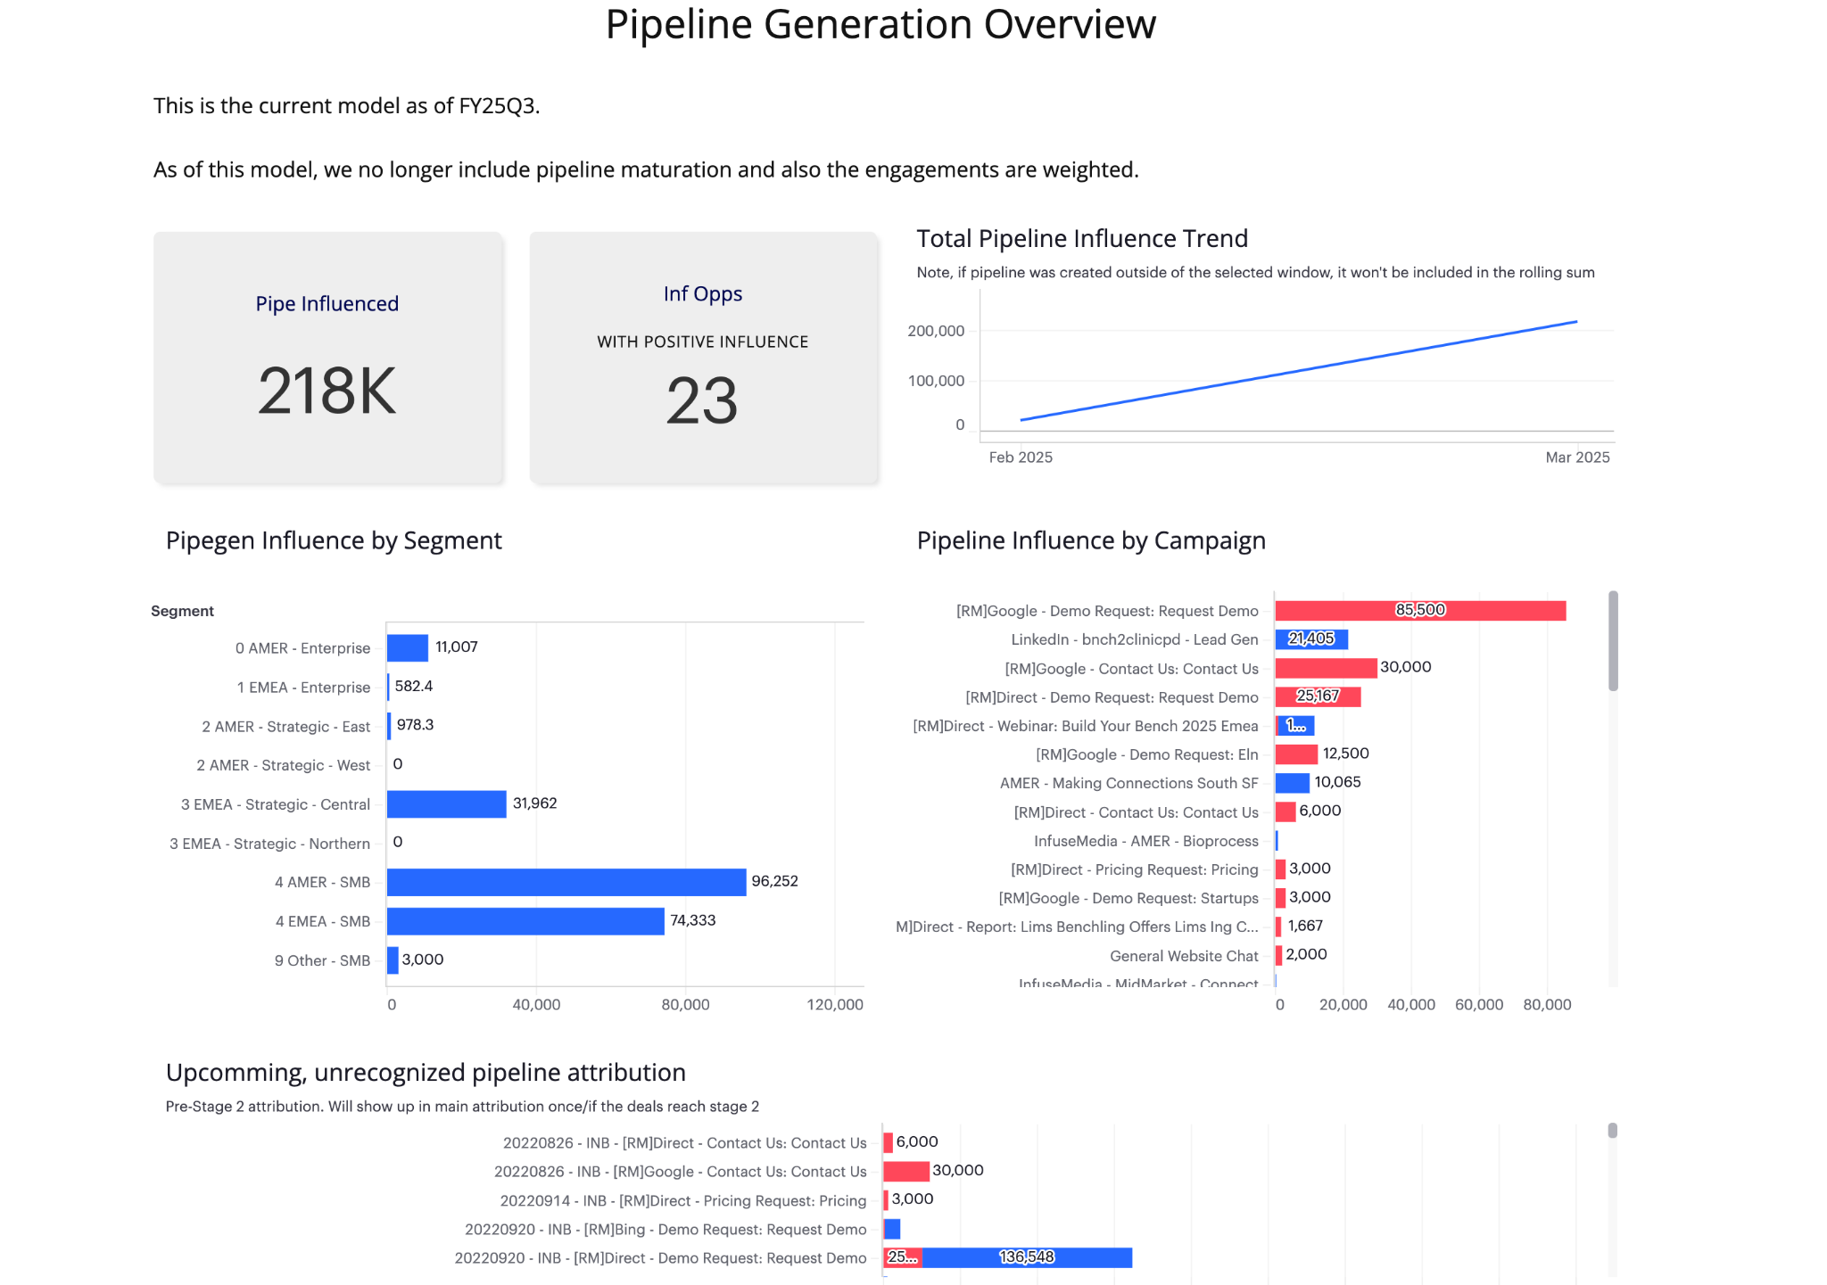
Welcome to the Campaign Process Workshop
Learn by Doing: Plan, Build, Execute, Reflect
Today, we won’t just learn the campaign process, we’ll build one together!
Look familiar?
Notes:
Walkthrough campaign building process; semi-interactive
Active participation
Through campaign lifecycle: first idea, execution and wrap up
We’ll build a campaign together
Familiar with looking at dashboards similar to this one, maybe even this exact one
Often times overlook the coordination, planning and setup that goes into getting that data or output into the dashboard
One key takeaway, workshop will help us better understand
The inputs and processes that allow the ability to track and analyze our campaigns

Slide 3
Workshop Flow
Campaign Planning (practice)
Submitting Intake Requests (practice)
Set up in systems (discussion)
Campaign execution (practice)
Post-Campaign Analysis & Retro (practice/discussion)
Notes:
Let’s take a quick look at what we’re covering today.
Planning and Ideation – where your campaign starts, using tools like the Plan on a Page and Airtable
Intake – the handoff to MOps, where you formally request support
System Setup – the backend configuration in Marketo, Salesforce, and Airtable
Execution – when your campaign goes live, and where real-time tracking matters
Post-Campaign Analysis – where we reflect, measure, and report outcomes
So with that — let’s start

Slide 4
Campaign Planning

Slide 5
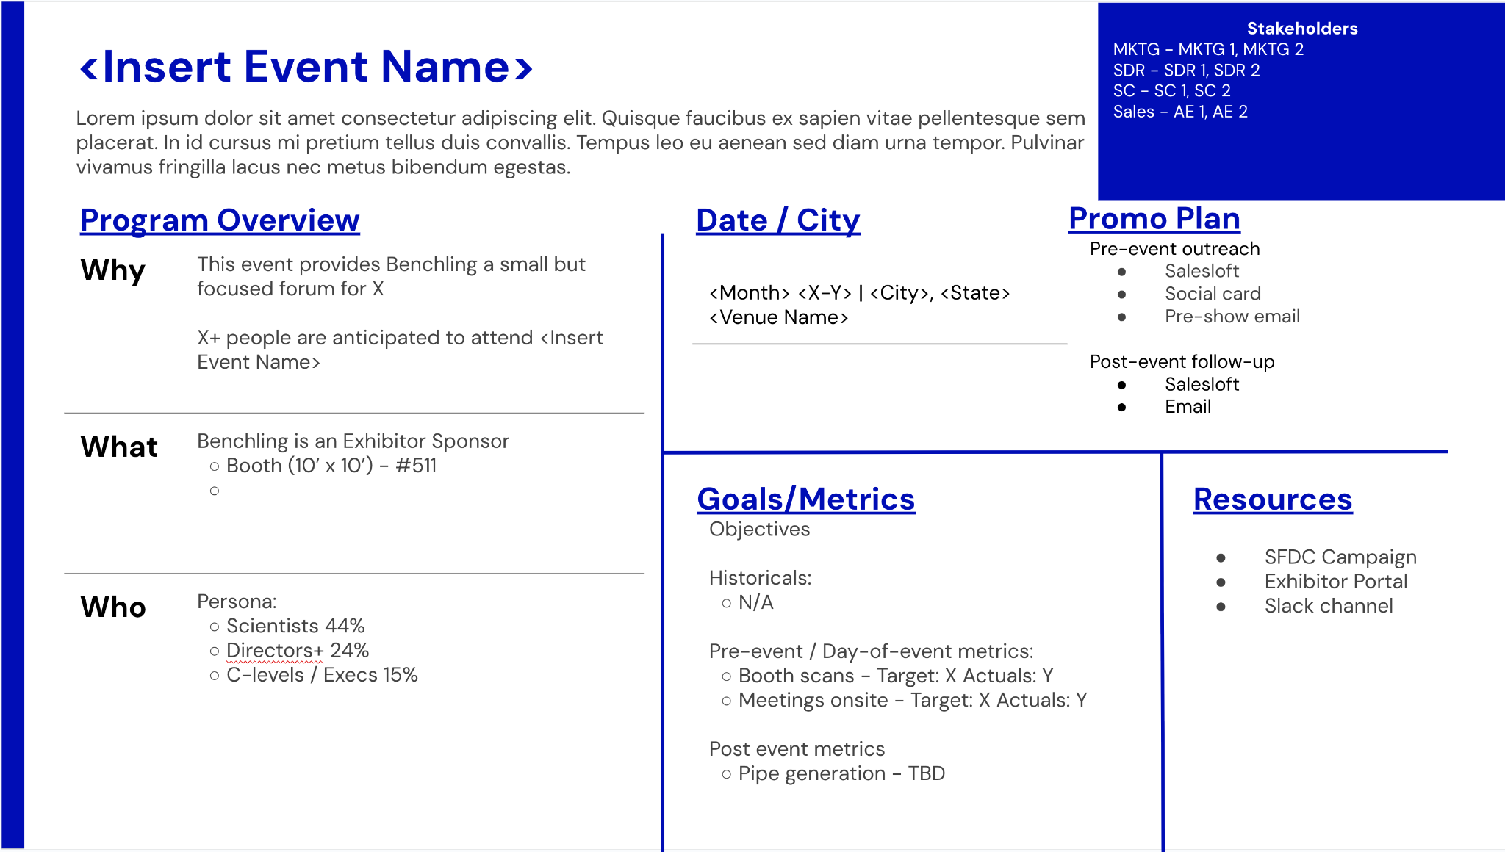
Planning and Ideation
Start with Plan on a Page to align stakeholders and resources
Notes:
Campaigns you should always start with is filling out a Plan on a Page.
Plan on a page is a resource to help explain:
Why are we doing this campaign?
Who is the audience we’re targeting?
What do we hope to achieve?
Where and how will it happen?
It’s also the alignment tool across teams.
gives xfunctional teams more clarity
helps everyone stay coordinated.

Slide 6
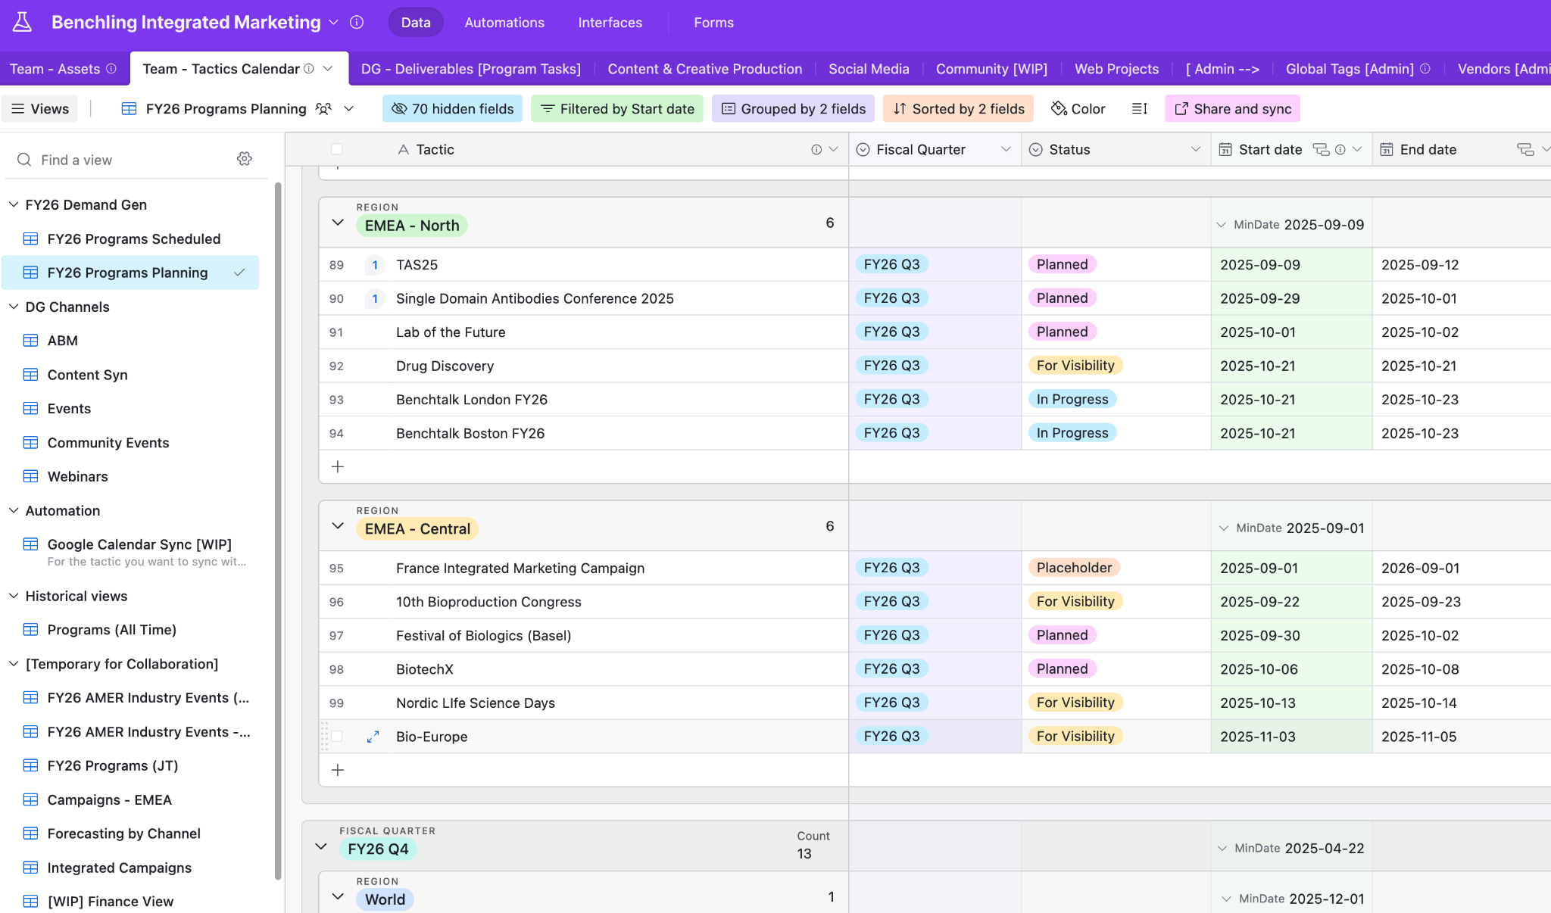
From Plan to Airtable
Enter key campaign details into Airtable
Set status to be visible in views
Team-Tactics Calendar
Notes:
Once your Plan on a Page is done and aligned with stakeholders, the next step is to bring that campaign into Airtable.
Can think of Airtable as our “Campaign Database”. This is where your campaign becomes visible to everyone else involved in the process.
When entering your campaign into Airtable, there are a few key things to make sure you include:
The campaign name
Your target region, start date, and owner
The correct marketing channel — email, event, webinar, etc.
And the campaign status
Ultimately, this is where your campaign starts to “exist” in the system. From here, every step of the process will reference this record.
Now it’s our turn to give this a try.
Pick a volunteer to help draft a campaign idea in Airtable — let’s use a campaign you’re currently working on, one you’ve done in the past, or something hypothetical that you think your team might run.
Use the campaign planning view we’ve provided, and make sure to include the required fields:
Campaign name
Which quarter
Status
Start Date / End date
Estimated Spend
Owner
Marketing Channel
Region
Plan on a page link
The goal here isn’t to get every detail perfect — this is meant to simulate the early planning phase where visibility and structure matter most.

Slide 7
Submitting Intake Requests

Slide 8
Submit an Intake Request
An intake request alerts the Marketing Ops team that you need campaign support
Include key information
Consider SLAs and setup complexity – earlier submission = smoother execution
Email sends: 1 week
Events & Webinars: 1-3 months in advance
List imports: 1-2 business days (dependent on list quality/readiness)
Marketing Ops SLAs
Notes:
Now that your campaign is planned and entered into Airtable, the next step is submitting an intake request for support, Marketing Operations.
This is where planning turns into activation.
The intake request is how Marketing Operations is notified of what/where you’ll need support for your campaign.
Important to include as much detail, to avoid back and forth
Timing is crucial
Some campaign types — like webinars with registration pages or multi-touch email nurtures — require much more setup time than others. That’s why we ask you to consider the SLAs and submit your request with enough lead time.
A good rule of thumb is: the more complex the campaign, the earlier you should submit. Which will benefit launch timelines and campaign performance.

Slide 9
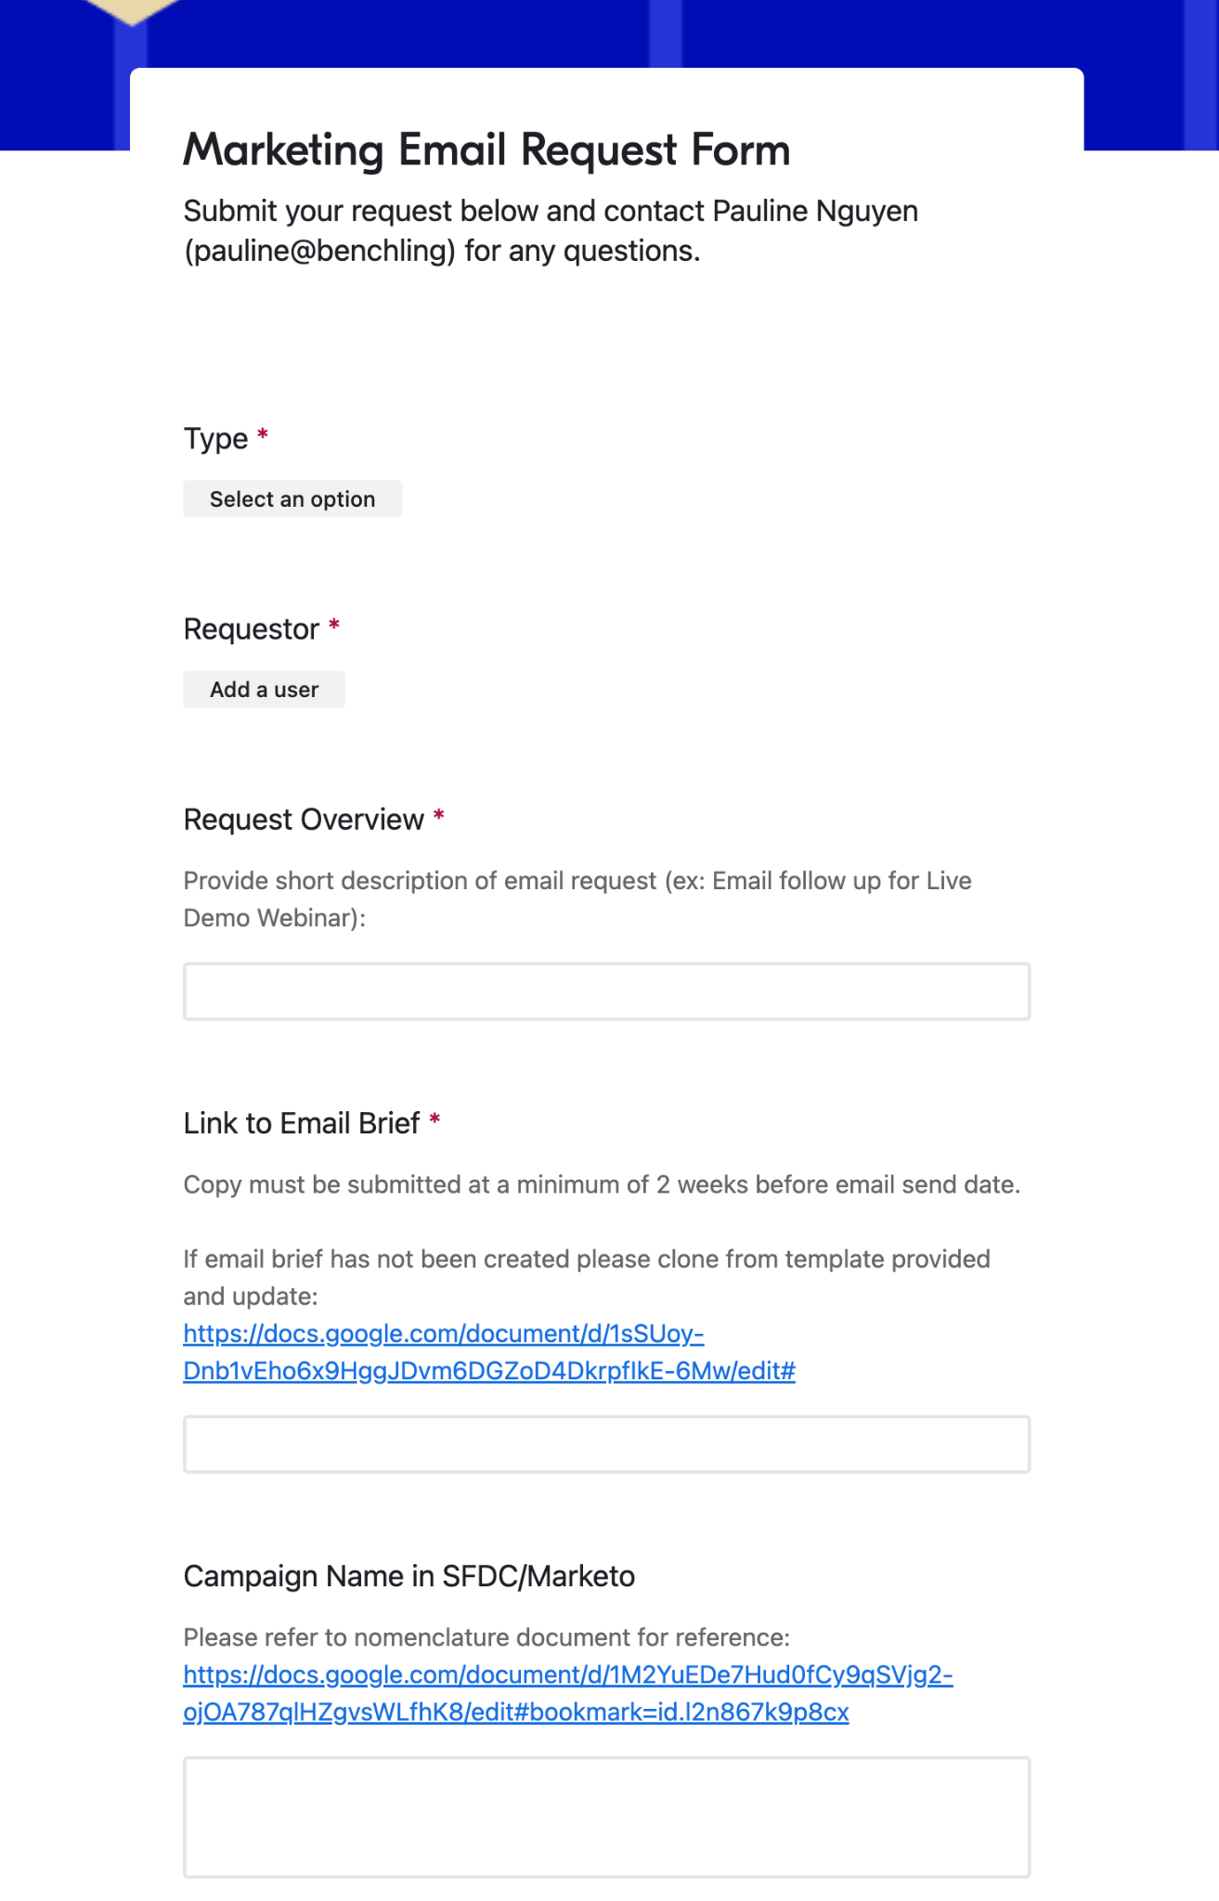
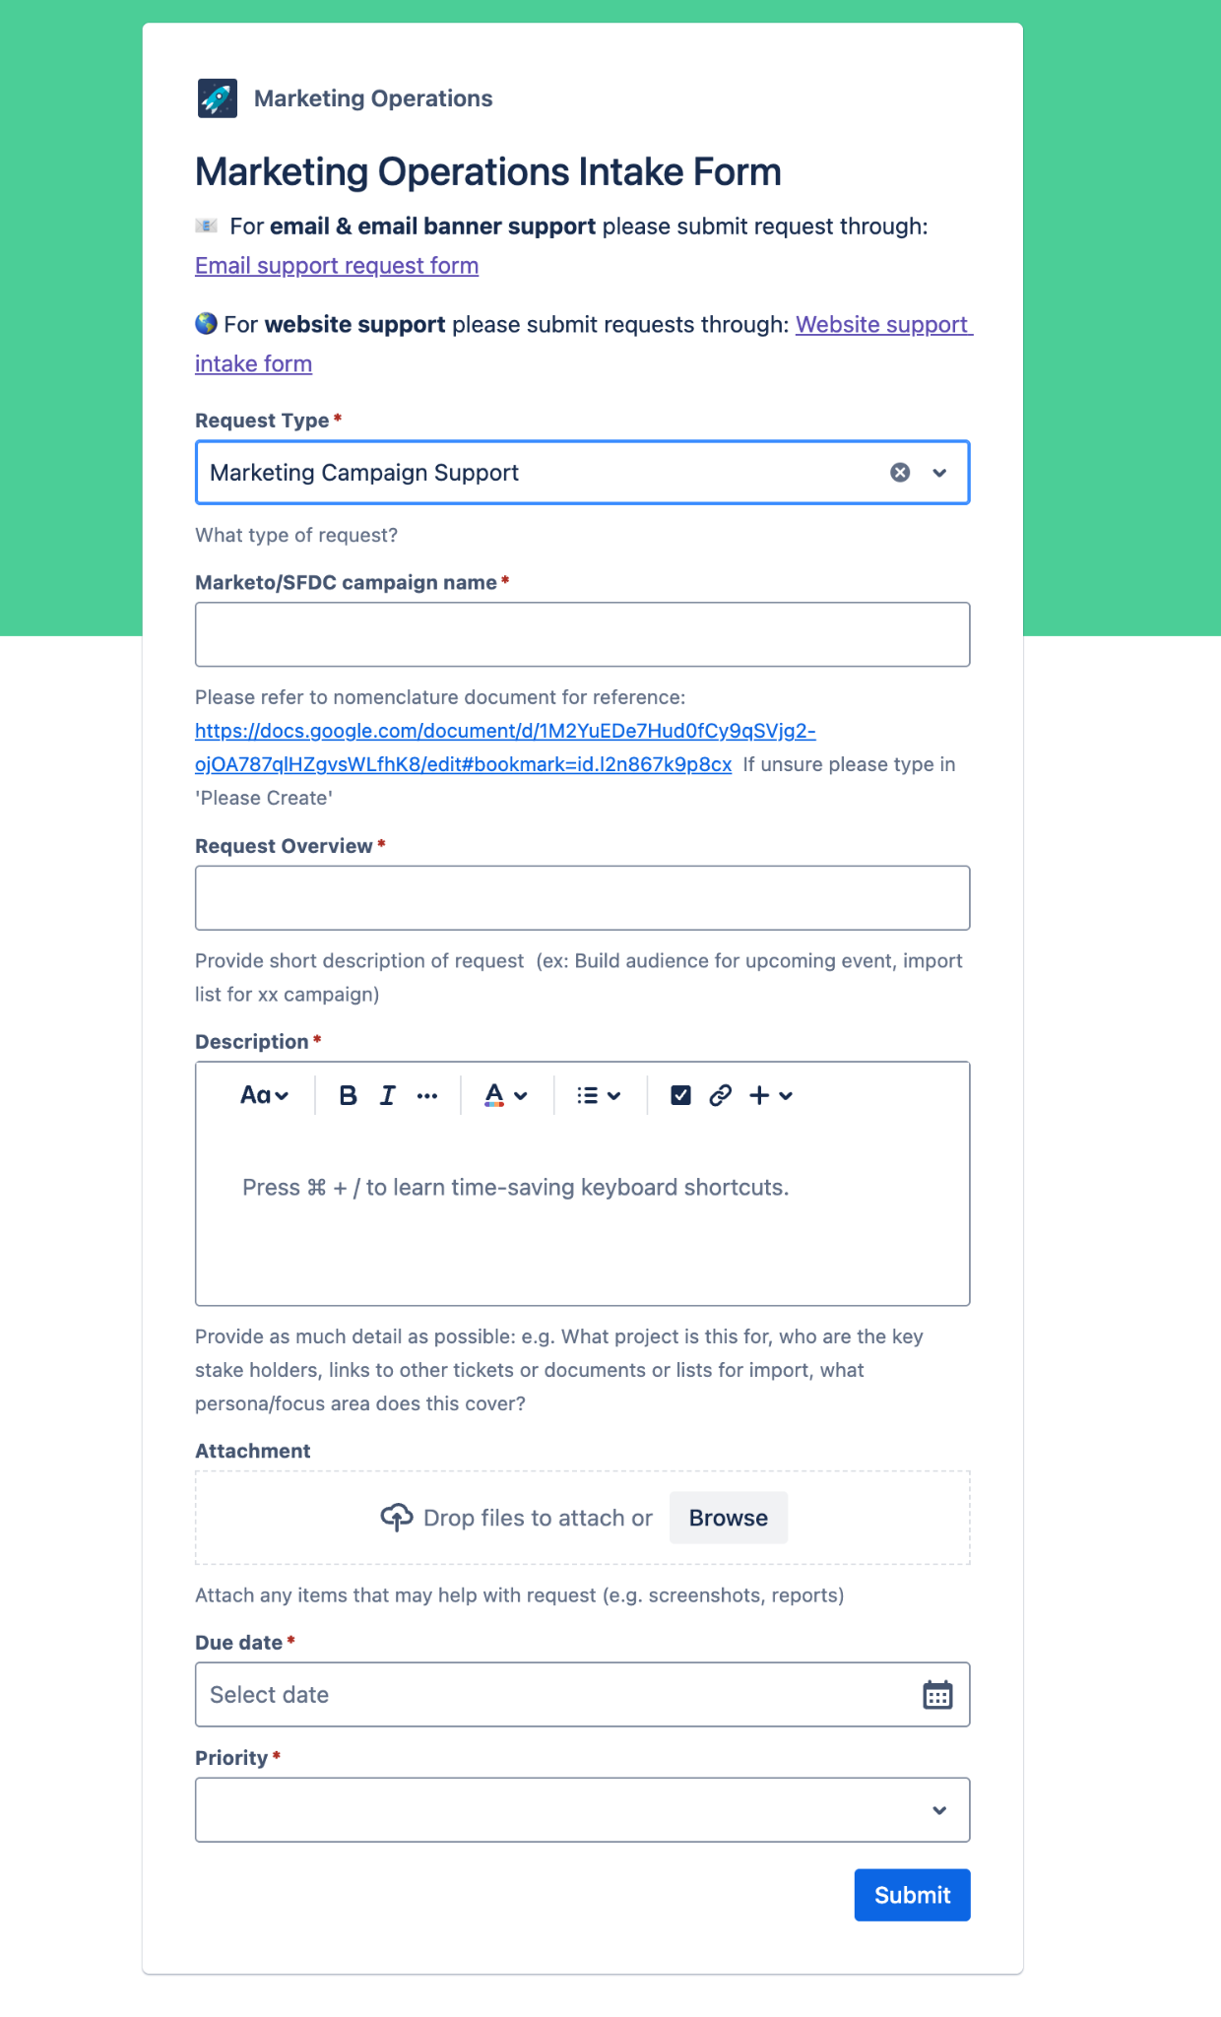
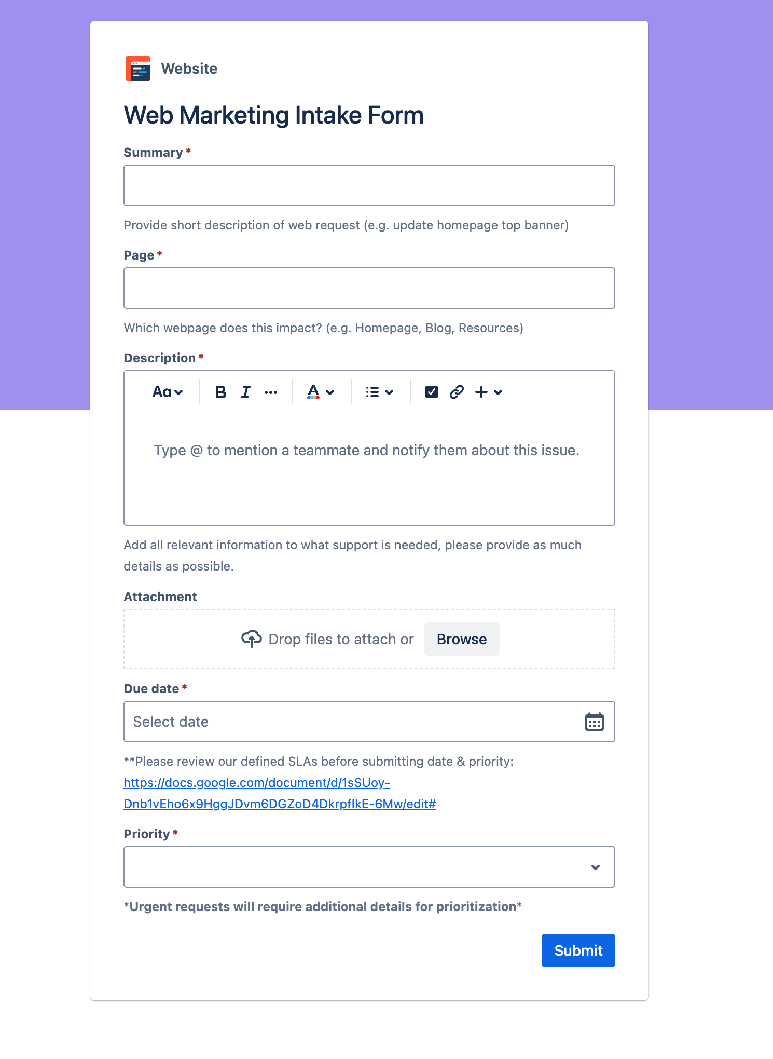
Submitting an Intake Request
Marketing Ops Intake form
Notes:
walk through the intake process by simulating a request submission.
You’ll be using the same campaign idea you drafted in Airtable during the last activity — and now you’ll take the next step by filling out an intake request.
The goal here is to practice clearly and completely communicating what support you need from Marketing Operations.
Think about what makes a request actionable:
What kind of campaign is it? (e.g. webinar, event, nurture email)
Who is the audience?
What assets will you need support building — emails, forms, landing pages?
What’s your desired launch date?
And do you have the Airtable ID or a link to the campaign record?
the more clarity and context you provide here, the more efficient your campaign setup will be.

Slide 10
Set Up in Systems

Slide 11
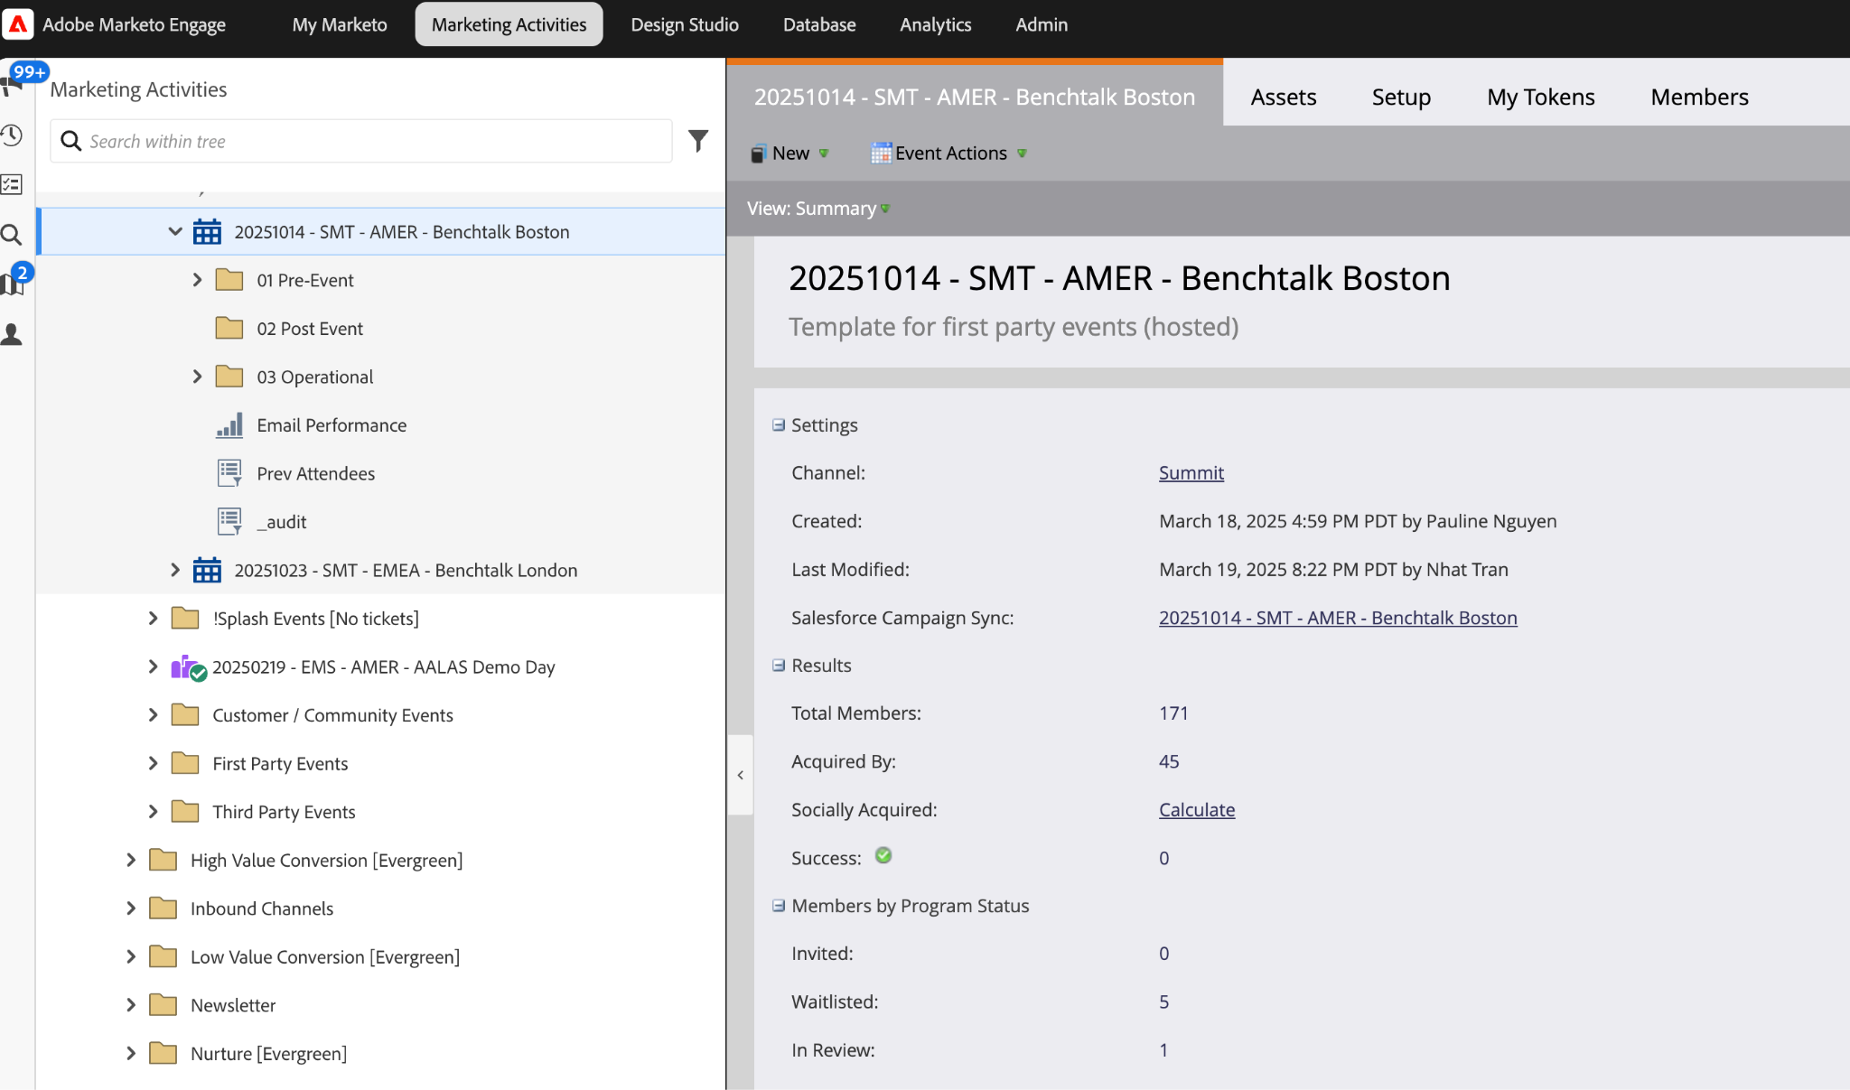
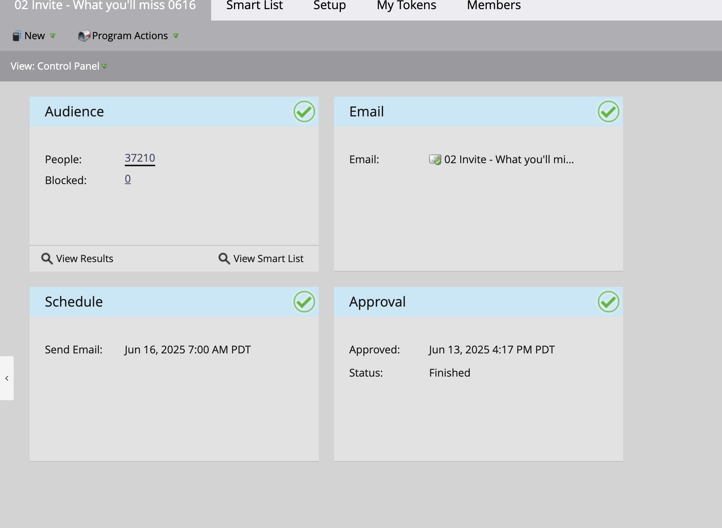
What Happens Behind the Scenes
Build program in Marketo
Set up for campaign type
Link to systems
Salesforce + Airtable
Connected and consistent
Notes:
Now that your campaign intake request is submitted, walk through what happens behind the scenes.
Depending on the channel or campaign type, we will build the program/campaign to support
This is where Marketing Operations will begin building your campaign and connecting it with all the systems.
Here's what typically happens:
First, the campaign is built in Marketo — this includes configuring the program type, audience segmentation, email logic, registration flows, etc.
Then, it’s linked to Salesforce to ensure campaign membership syncs properly
We’ll also make sure the campaign is aligned in Airtable, so information such as status, spend, and etc.. are connected and consistent across all systems.

Slide 12
Ensuring Consistency Across Systems
Marketing Ops = Stewards of Marketing data
Standardization results in:
System-wide alignment
Clean reporting and reliable attribution
Clarity and trust in the data
Campaign structure & nomenclature
Notes:
Emphasize importance of ensuring consistency across systems
When we say “standardization,” we’re talking about consistent naming conventions, relevant data, and campaign structure across all systems.
For example:
If campaign names don’t follow a clear format, it’s harder to connect assets across tools
If a campaign isn’t linked correctly, attribution may be missed
If program statuses aren’t aligned to success metrics, we lose visibility on performance
These details create clarity and trust in the data.
Let’s open it up:
Where have you seen inconsistent setup cause confusion or extra work?
What best practices do you follow or wish were more widely adopted?

Slide 13
Campaign Execution

Slide 14
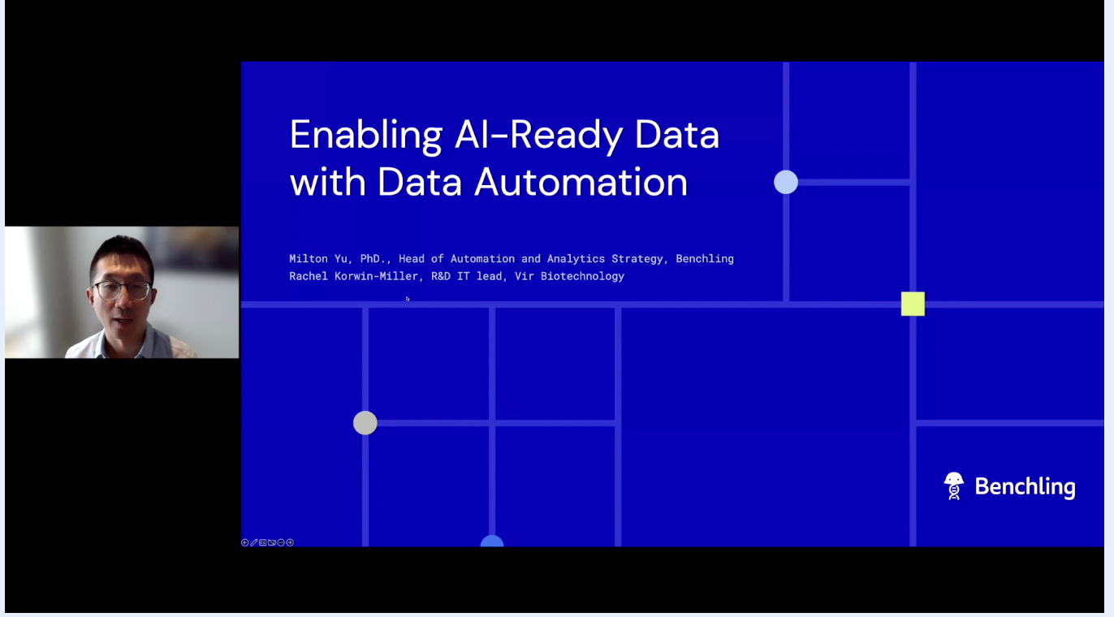
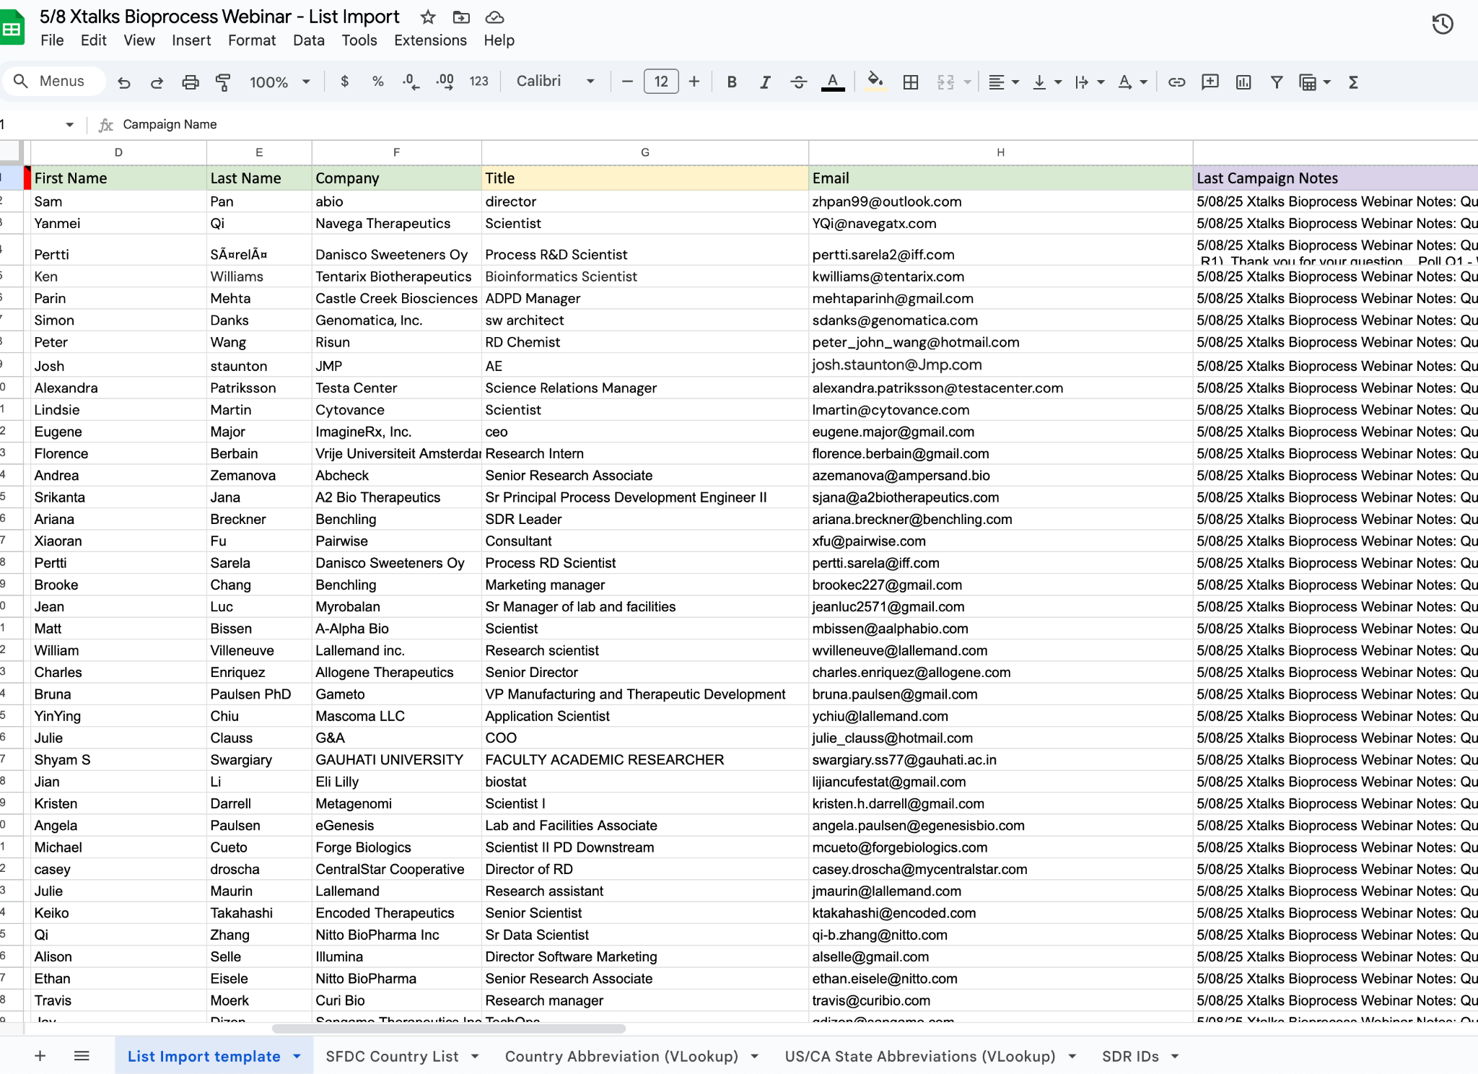
Campaign Execution
Event/Program Launch
Marketing Operations support
List imports
Status updates
MQL/MSL process
Notes:
This is when everything becomes visible — your campaign launches, and your audience starts engaging
Whether it’s a email, a webinar or events
At this point, Marketing Operations is supporting with:
Ensuring successful scheduled emails
Importing lists
Ensuring that lead scoring and MQL logic is functioning properly
If your intake request was incomplete, or if your Airtable campaign record is missing required fields, MOps may have to pause or fix things on the fly — and that can lead to delays or improper campaign execution.
So while this phase might look like “just clicking send,” it’s actually the most operationally demanding part of the process — and it only works if everything leading up to it was well structured.

Slide 15
Understanding List Imports
List import fields and which are key to a successful import.
List Import Template
Notes:
I would like to cover an essential part of campaign execution, list imports.
One of the main sources of contacts in our databases, from webinars, events, content syndication.
making sure the right fields are populated so those leads can flow through our scoring, routing, and reporting processes correctly.
Some of the most important fields to get right during import are:
Email address (of course!)
Country
Notes
MQL
If these are missing or inconsistent, it can break attribution — or worse, leave leads untracked and unqualified.
So let’s open it up:
What questions do you have about how these statuses are used?

Slide 16
Post-Campaign Analytics & Retro

Slide 17
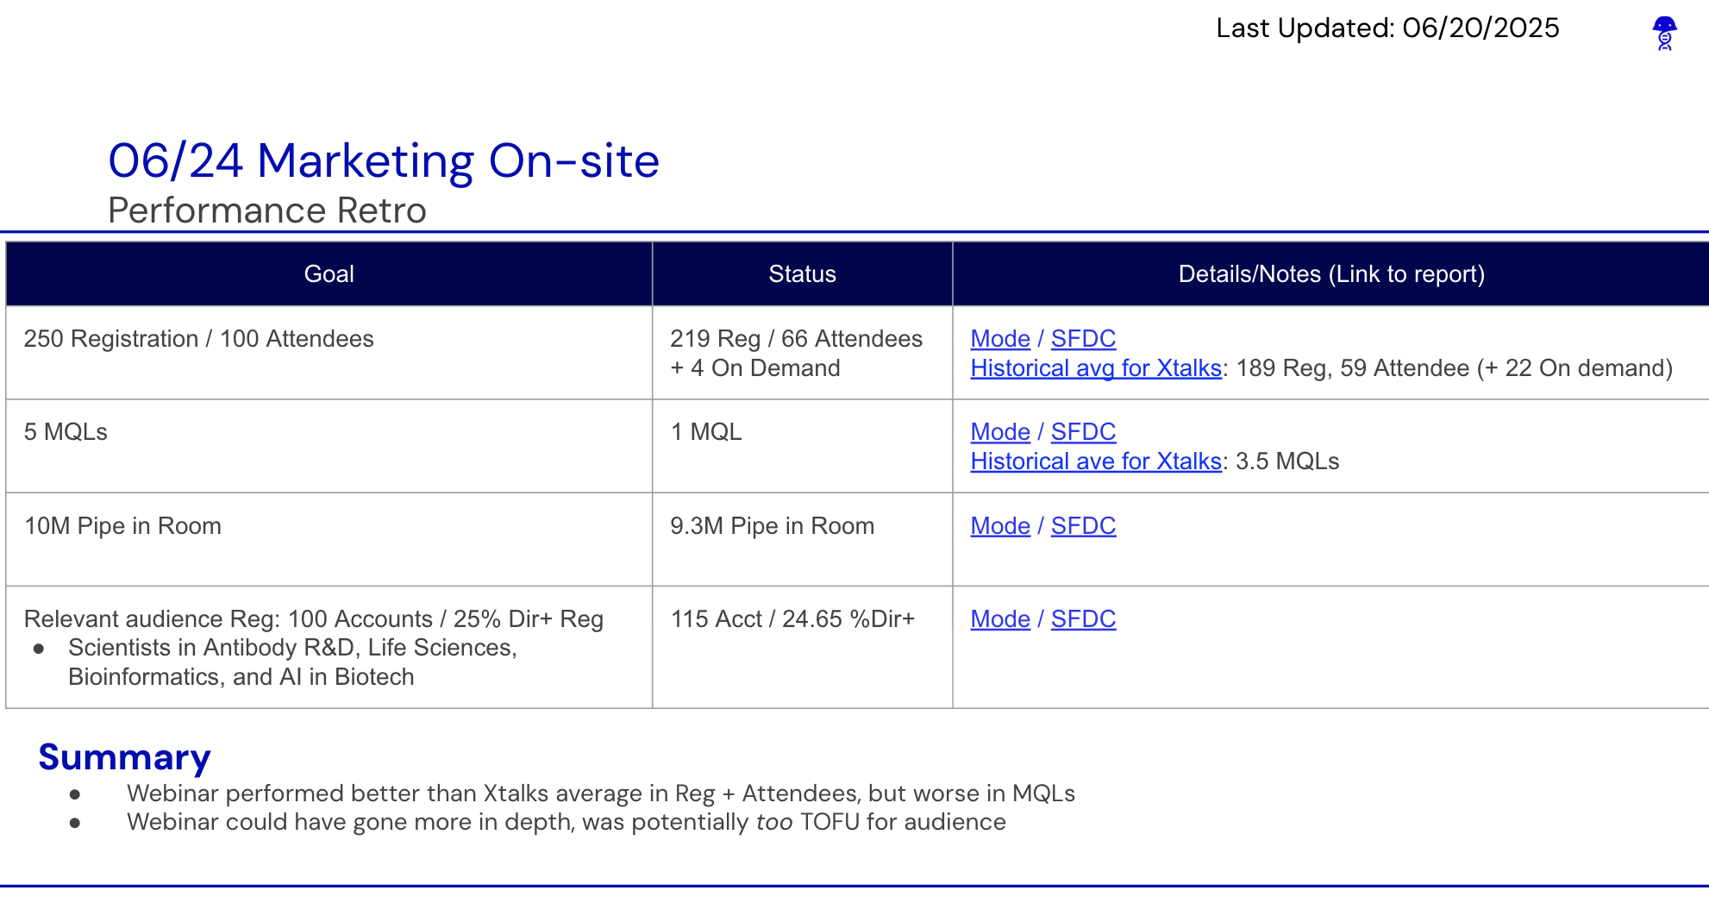
What to Do After the Launch?
Analyze campaign performance: Campaign performance dashboard
Fill in retro slide & budget in Airtable
Finalize insights, close campaign
Notes:
Now let’s talk about what happens after launch has completed,
The next step is to review the data using the campaign performance dashboard. This dashboard gives us a consistent way to evaluate what happened.
Here’s what we’re typically looking at:
Segment performance
Lead generation and quality
Pipeline metrics
Engagement health:
This data helps us answer: Was the campaign successful by the measures we defined at the beginning? And if something didn’t perform as expected, where in the flow did we lose momentum?
Most importantly, this analysis helps us improve — not just for the next campaign, but across our entire marketing motion.
If your campaign was set up correctly — with consistent naming, Airtable syncing, and platform alignment — this data is automatically captured and visible in a standardized way. That’s why each step we took earlier matters so much.
About two weeks after the campaign launches, it’s time to update the campaign retro and Airtable with post-campaign information — things like actual spend, final attendee counts, and other key metrics.
At the end of the quarter, we use this data to synthesize broader insights: What worked? Where did we see high engagement? Were there gaps in follow-up or unexpected blockers?
Closing the campaign loop is what ensures our next one is even stronger. And it’s what allows us to connect campaign performance to pipeline — so the business sees how marketing is driving results.

Slide 18
Notes:
How do people become MQLs?
How does scoring work?
How are leads/contacts routed?
When does Mode update?

Slide 19
Campaign Process
Campaign planning in Airtable
During initial ideation/planning
Team-Tactics calendar in Airtable
Set status to: For Visibility, Placeholder, Planned
By the start of the relevant quarter; link to Airtable
Submit intake request
When the topic & date are finalized.
Include Airtable ID
Initiates campaign build and integration across platforms
Set up systems for launch
Campaigns set up in Marketo and Salesforce
Marketing Ops manages SFDC campaign details & linking to Airtable
Campaign execution
Event/program launched
Marketing Operations will support with campaign executions (list imports, status updates, MQL/MSL pushes)
Progress maintained in Airtable using defined views
Updates in Tactics table will update SFDC campaign details (status, start/end date, spend)
Post-campaign
Analyze campaign performance
Two weeks after event: update retro slide and budget fields in Airtable
End of quarter: finalize retro insights and close out campaign loop.
Notes:
1. Campaign Planning in Airtable
When: During initial ideation.
What to do: Add the campaign to Airtable using Placeholder or Planned status.
Why: Ensures visibility and alignment across teams.
Tip: Link to a central Airtable view and aim to finalize campaign topic and date before the relevant quarter begins.
2. Submit Marketo Ticket
When: Once the topic and date are confirmed.
What to include: Airtable ID and all relevant details.
Why: Initiates campaign build and integration across platforms.
3. Campaign Creation by MOPs
What happens:
MOPs team sets up the campaign in Marketo and Salesforce.
Campaign info (name, ID, etc.) is synced back into Airtable.
Why: Aligns records and ensures system-wide consistency.
4. Campaign Execution
What: Email/event/program is launched.
Tracking: Progress is maintained in Airtable using defined views.
5. Post-Campaign Activities
2 Weeks After Event:
Update retro slide and budget fields in Airtable.
End of Quarter:
Finalize retro insights and close out the campaign loop.
📝 Notes
Views: Ensure you're using the correct Airtable view for campaign planning.
Minimum Info Needed in Airtable:
Tactic/campaign name
Start date
Marketing channel/campaign type
Region
Owner
Airtable ID

